Slide 1
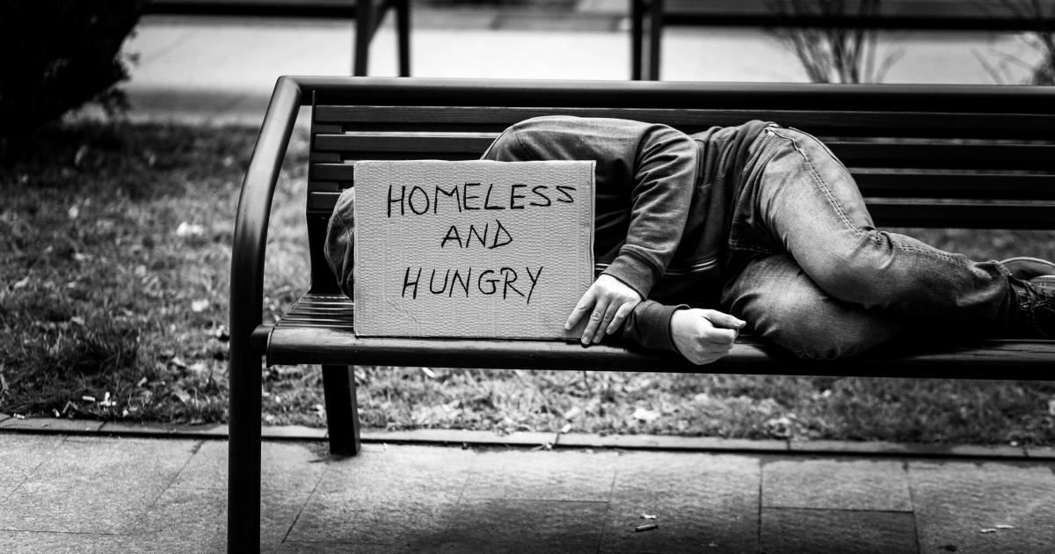
Homeless Trends: A Data-Driven Exploration
Archana Tata

Slide 2
Introduction & Research Questions
Homelessness is a complex social issue. Our goal is to identify the factors that have either positive or negative impacts on the homeless population.
Is FMR associated with homelessness rate?
Is poverty rate associated with homelessness rate?
Is unemployment rate associated with homelessness rate?
Is median income associated with homelessness rate?
Is minimum wage associated with homelessness rate?
Is median gross rent associated with homelessness rate? Does this relationship vary based on the number of bedrooms?

Slide 3
Datasets
Dataset | Source | Time Span
Homeless PIT count | Department of Housing and Urban Development(HUD) | 2015 - 2019
Average annual FMR per state | Department of Housing and Urban Development(HUD) | 2015 - 2019
Median Gross Rent by Bedrooms per state by year | Cencus.gov | 2015 - 2019
Median Income by State | Cencus.gov | 2015 - 2019
Poverty Rates by State | Cencus.gov | 2015 - 2019
Minimum Wage per state per year | US Department of Labor(DOL) | 2015 - 2019
Unemployment rate per state per year | Bureau of Labor Statistics | 2015 - 2019

Slide 4
Variables
Dependent Variables | Independent Variables
Family Homeless Rates | Median Gross Rent(MGR) - Studio Apt
Individual Homeless Rates | Market Rent(FMR) - Studio Apt
 | Minimum Wage
 | Unemployment Rate
 | Poverty Rate
 | Median Income

Slide 5
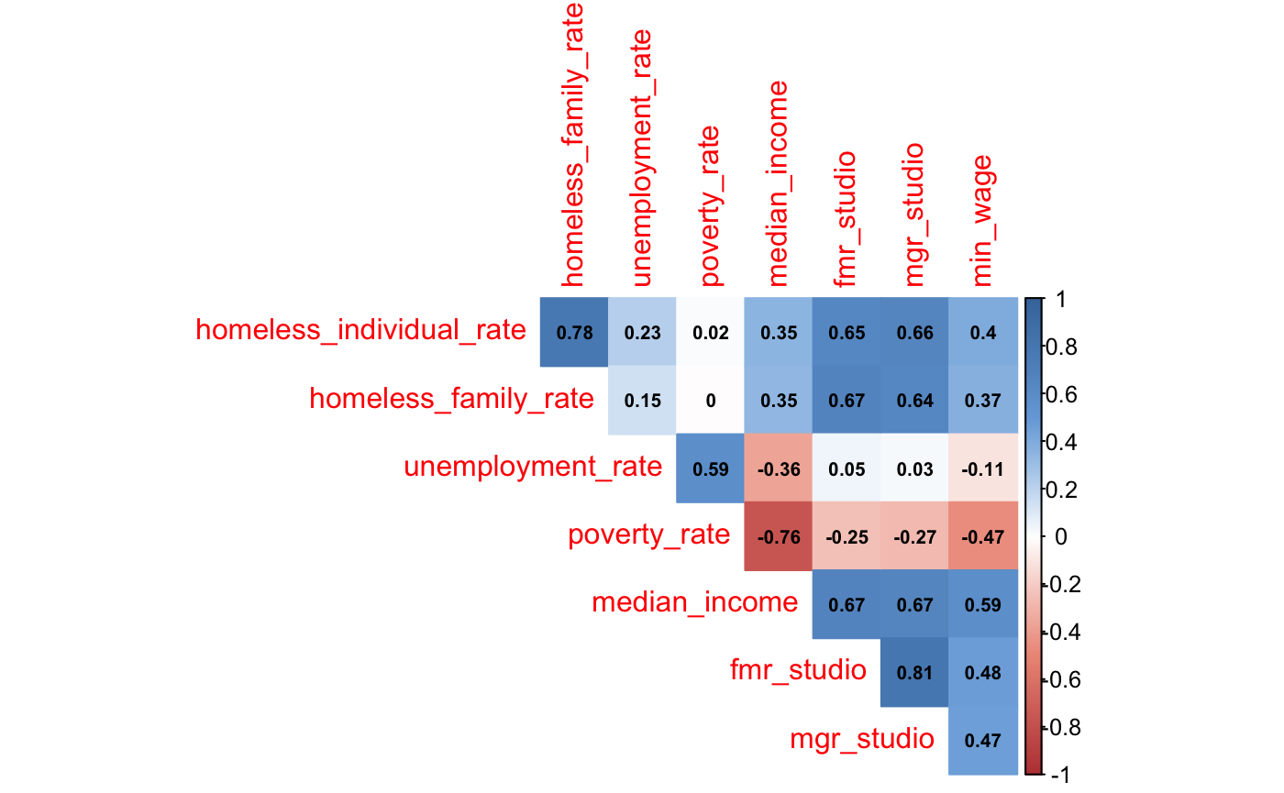
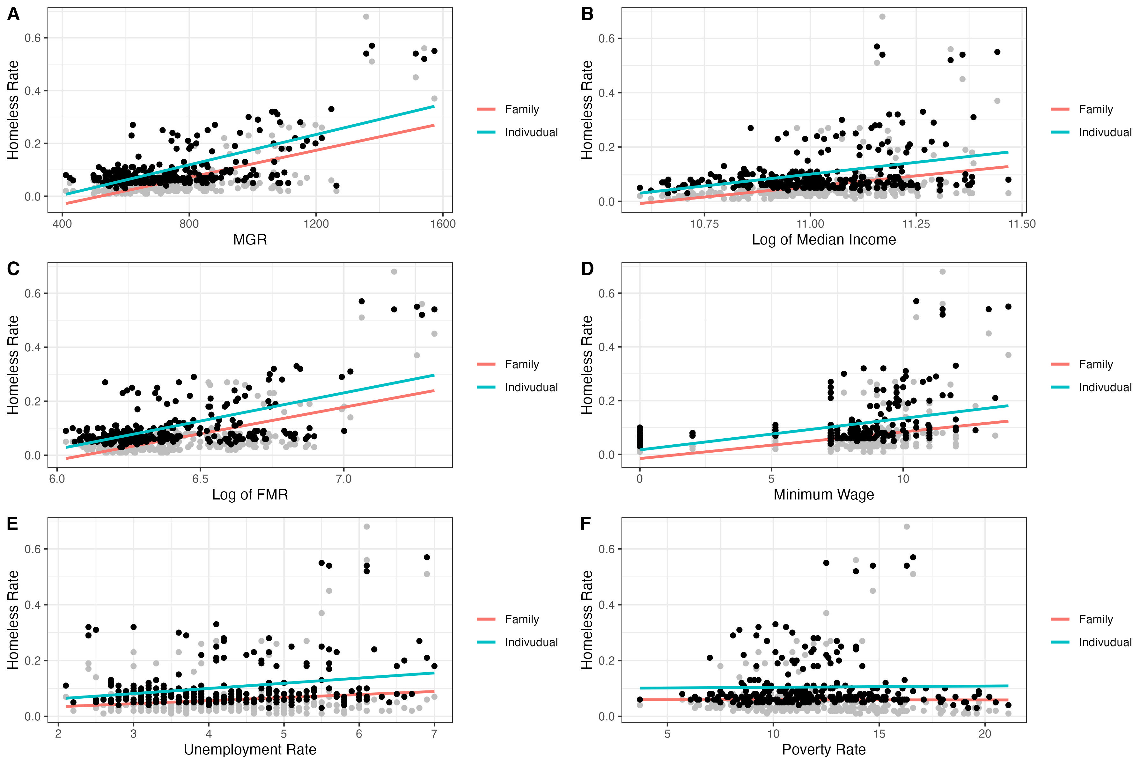
Homeless Rate for Family and Individual Against All Predictor Variables
Correlation Between Variables

Slide 6
Multivariate Regression | Statistically Significant P Values
Individual Homeless Rate as Dependent Variable
Family Homeless Rate as Dependent Variable
Minimum Wage
Median Gross Rent Studio Apt
Fair Market Rent Studio Apt
Minimum Wage
Median Gross Rent Studio Apt
Fair Market Rent Studio Apt
Pr(>|t|)
Pr(>|t|)
0.000174
0.00306
1.03e-07
9.60e-06
0.000481
9.86e-09
Notes:
Multivariate regression is a statistical technique used to understand the relationship between multiple independent variables and more than one dependent variable. It is useful for exploring complex relationships where multiple outcomes are influenced by multiple variables at the same time. Our model predicts 'homeless individual rate' and 'homeless family rate' based on the relationship with each independent variable. The variables used in the model are unemployment rate, poverty rate, median income, minimum wage, Gross median rent for studio apartments, and FMR for studio apartments
The outcome was the same for each dependent variable and an increase in minimum wage, GMR, or FMR resulted in an increase in the homelessness rate for both individuals and families, however the same is not true for the unemployment rate, poverty rate, or median income.
The model fit is marginal at 50%
Adjusted R Squared for Individual = 0.5426
Adjusted R Squared for Families = 0.5281

Slide 7
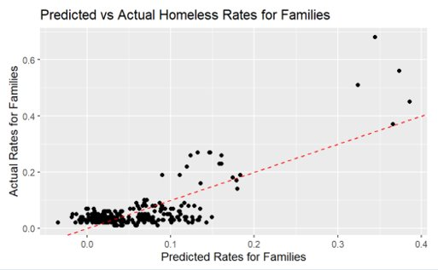
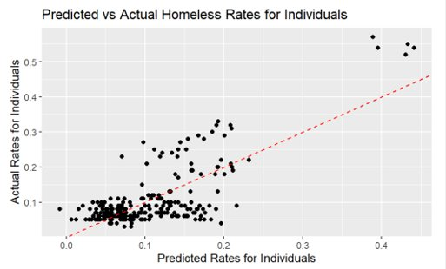
Multivariate Regression | Predicted Rates vs Actual Rates
Notes:
There is greater variability in the predictions at the higher rates of homelessness, which is indicated by the red dashed line. As the predicted rate increases, the actual rate tends to increase, more so in the individual homeless rate. This implies that the model is capturing some part of the underlying relationship between the predictors and the individual homelessness rate.
There are several points that deviate significantly from the red dashed line, especially at the higher values. This suggests that the model predictions are less accurate in these ranges. It could be a sign that the model does not fully capture the complexity of the factors influencing higher rates of family or Individual homelessness.

Slide 8
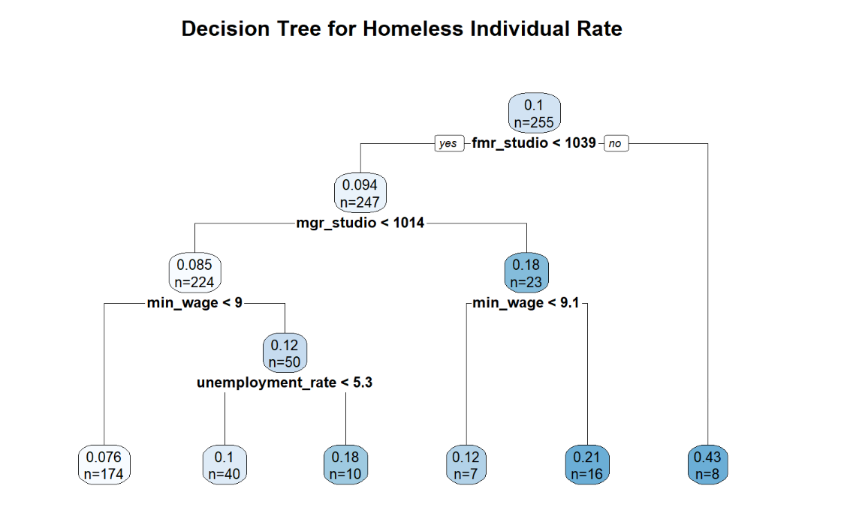
Understanding Predictive Insights for Homelessness Rates
Variable Importance for Homeless Individual Rate Prediction
Variable | Value
FMR - Studio | 0.87785674
MGR - Studio | 0.73449026
Minimum Wage | 0.35470063
Median Income | 0.13672423
Unemployment Rate | 0.05343659

Slide 9
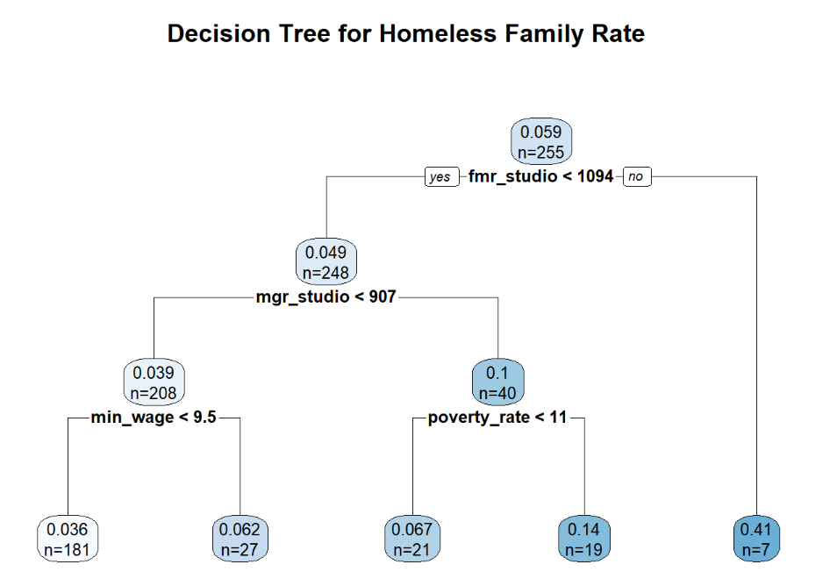
Understanding Predictive Insights for Homelessness Rates
Variable Importance for Homeless Family Rate Prediction
Variable | Value
FMR - Studio | 0.95772948
MGR - Studio | 0.78240228
Minimum Wage | 0.31460408
Median Income | 0.18733503
Poverty Rate | 0.05364333
Unemployment Rate | 0.02664021

Slide 10
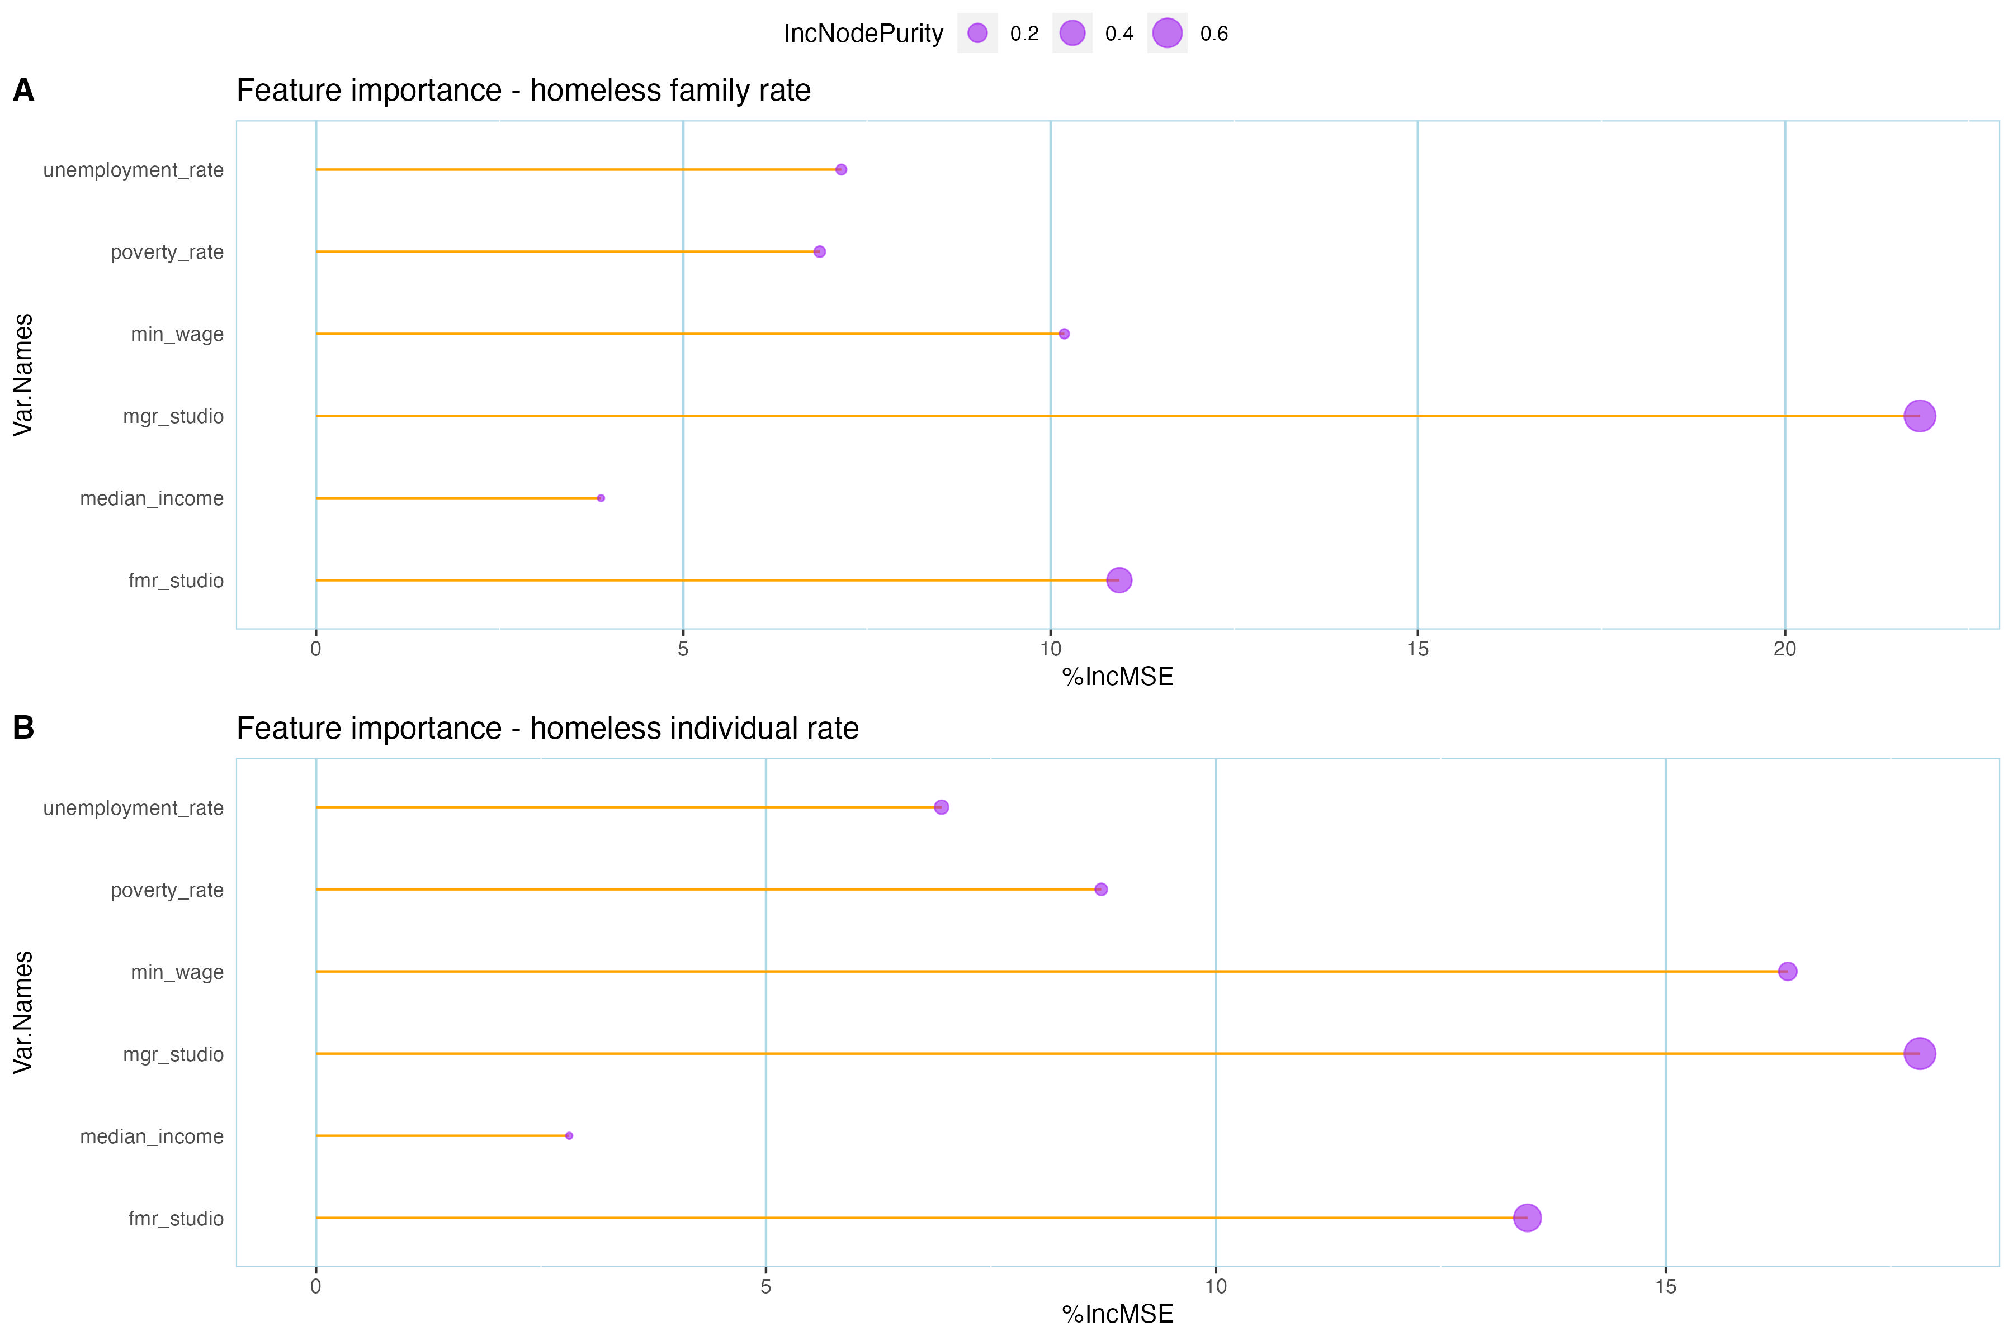
Random Forest Model
Ran RF model on all 6 predictors independently.
Ran RF model on combinations of predictors
Identified top predictors from Feature importance plot
Used trainControl() and train() functions from the caret library to tune the parameters ntree to 300 and mtry to 4

Slide 11
Model Performance
The model was run with MGR and FMR of Studio, 1BHK and 2BHK apartment to see if one was better than the other
The MGR and FMR for studio apartments predicted better than the others
The model was better at predicting the Homeless Family rate than the individual rate.
The best combination of MSE and % var explained were computed with Studio apartment.
FMR and MGR Studio | Homeless Rate - Family | Homeless Rate - Individual
R2 | 0.7408 | 0.5834
MSE | 0.00242 | 0.00270
RMSE | 0.04881 | 0.05132
% var explained | 69.03 | 67.28
FMR and MGR 1BHK
R2 | 0.6657 | 0.5657
MSE | 0.00152 | 0.00309
RMSE | 0.05459 | 0.04667
% var explained | 61.26 | 73.27
FMR and MGR 2BHK
R2 | 0.50907 | 0.64725
MSE | 0.00240 | 0.00228
RMSE | 0.05247 | 0.05532
% var explained | 61.11 | 60.93

Slide 12
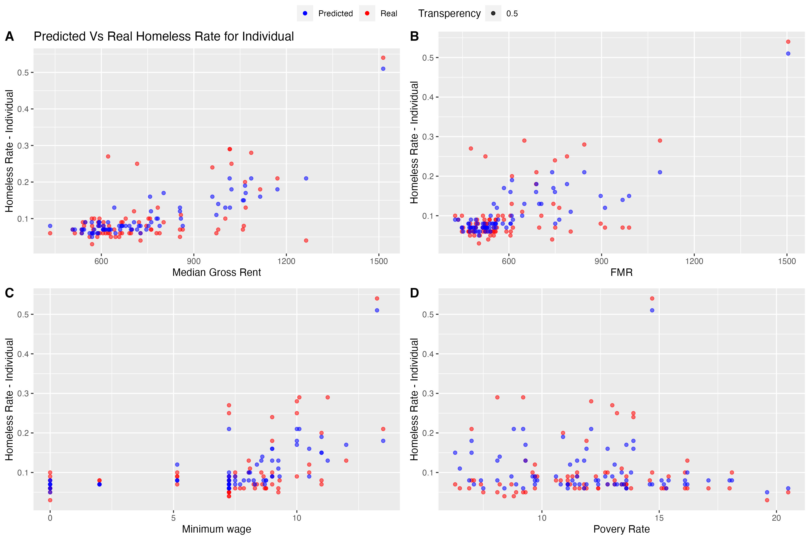
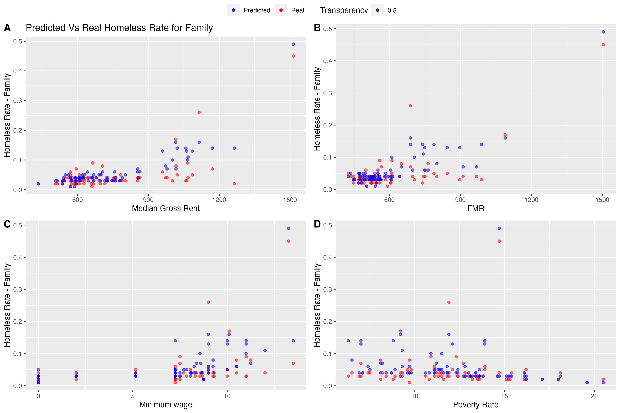
Predicted vs Actual Rates
In the lower homeless rate values, the predicted values align more closely to actual
As the rate goes up, we start seeing more variance
We can see the predicted and actual rates against the four top predictors in the following plots

Slide 13
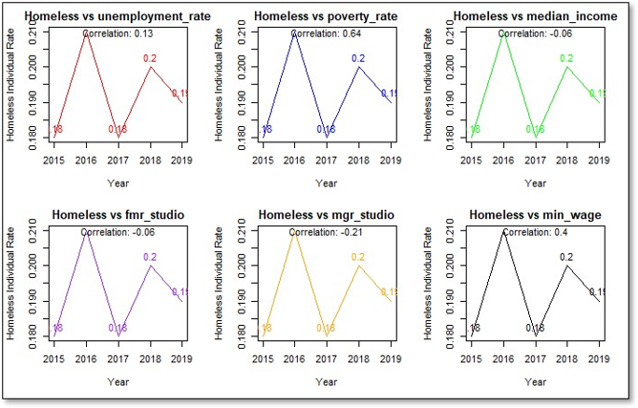
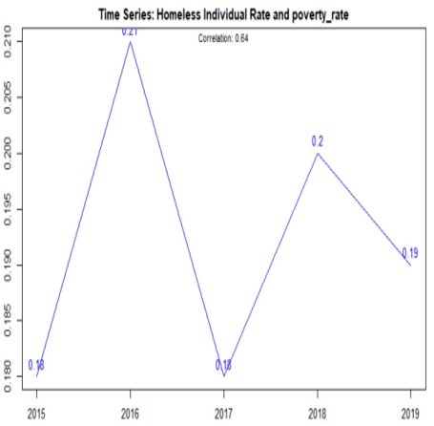
Time Series Regression | Individual Homeless Rates and Independent Variables

Slide 14
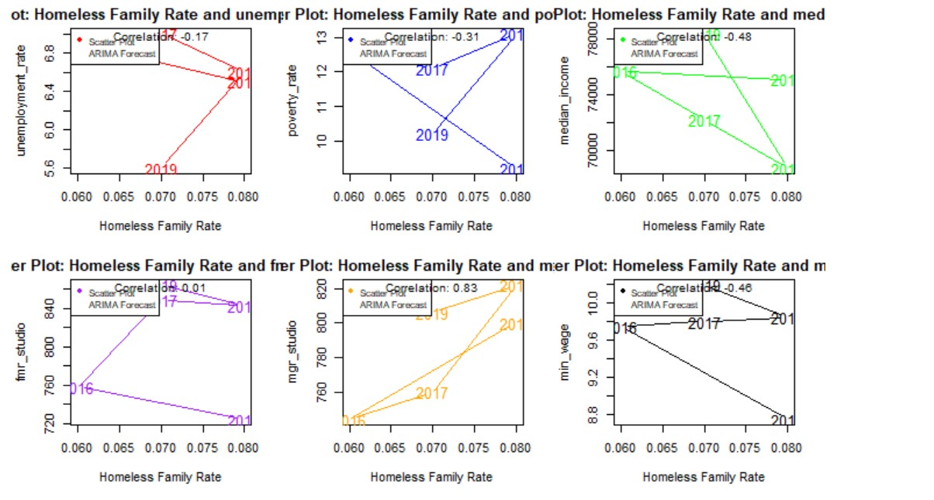
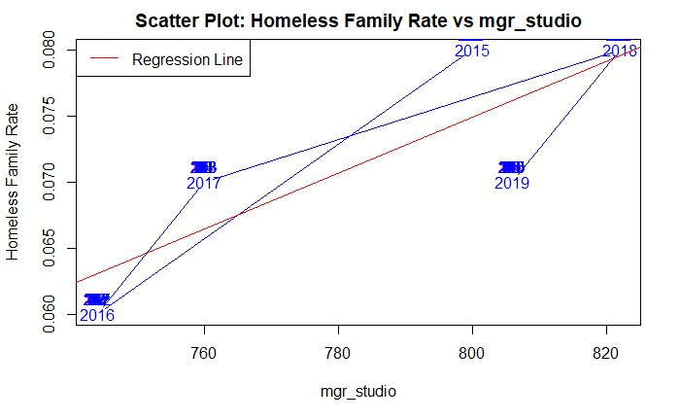
Time Series Regression |Family Homeless Rates and Independent Variables

Slide 15



Results and Discussion
Is FMR associated with homelessness rate?
Yes, our models demonstrated a positive relationship.
Yes, our models indicated that the MGR of a studio apartment has the strongest relationship
Is median gross rent associated with homelessness rate? Does this relationship vary based on the number of bedrooms?
Is minimum wage associated with homelessness rate?
Yes, there is a statistically significant positive relationship.
No, our models did not show a significant relationship.
Is median income associated with homelessness rate?
No, our models did not show a significant relationship.
Is poverty rate associated with homelessness rate?
No, our models did not show a significant relationship.
Is unemployment rate associated with homelessness rate?
Notes:
Across all models an increase in the FMR for a studio apartment, median gross rent for a studio apartment, and the minimum wage all increased the rate of homelessness for both individuals and families.
Median gross rent for a studio apartment has a positive relationship with individual and family homeless rates. We chose to use only MGR for studio apartments because early models indicated collinearity between studio apartments and 1 bedroom apartments. We also chose to exclude 2 bedroom apartments because early models indicated that there was very little relationship.

Slide 16
Conclusion
Across all models the same three independent variables showed as having a statistically significant positive relationship to both dependent variables: individual homeless rate and family homeless rate.
We were surprised that unemployment and poverty rates did not show a positive relationship to the dependent variables.
We recognize that there are limitations to our models as there are likely other variables that have an impact on homeless rates.
Further investigation would need to be done as to why homelessness increases with the FMR, this could indicate that by the time policy makers have increased the FMR the homeless population has already increased. Policy makers could investigate intervening sooner.
Notes:
The fair market rent for studio apartments was the strongest predictor across all models, however, caution should be taken before giving full confidence to the results. There are some factors that should be further examined.
For instance, we do not know what determinants are used by the government when deciding how to adjust the value of the fair market rent vouchers, it is possible, and likely, that some of the variables we have used as predictors are also included in calculating the FMR.
Another possibility is that the linear relationship between FMR and homelessness is created by other factors. Perhaps the government is not recognizing predictors early enough and responding too late, therefore by the time the fair market rent values are increased homeless rates have already risen, creating a false relationship. This would be an interesting question for further investigation. Correctly identifying the predictors, especially the early predictors, could influence some governments to respond faster and increase voucher amounts in areas with rising costs and prevent further increases in homelessness early on.

